Slide 2


Analysis of FPAs in the LHC RB circuit
Christoph Obermair, TE-MPE-CB Lukas Felsberger, TE-MPE-MI Franz Pernkopf, TU-Graz Andrea Apollonio, TE-MPE-CB Daniel Wollmann, TE-MPE-CB

Slide 3
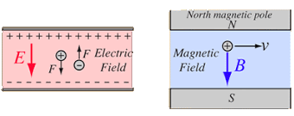
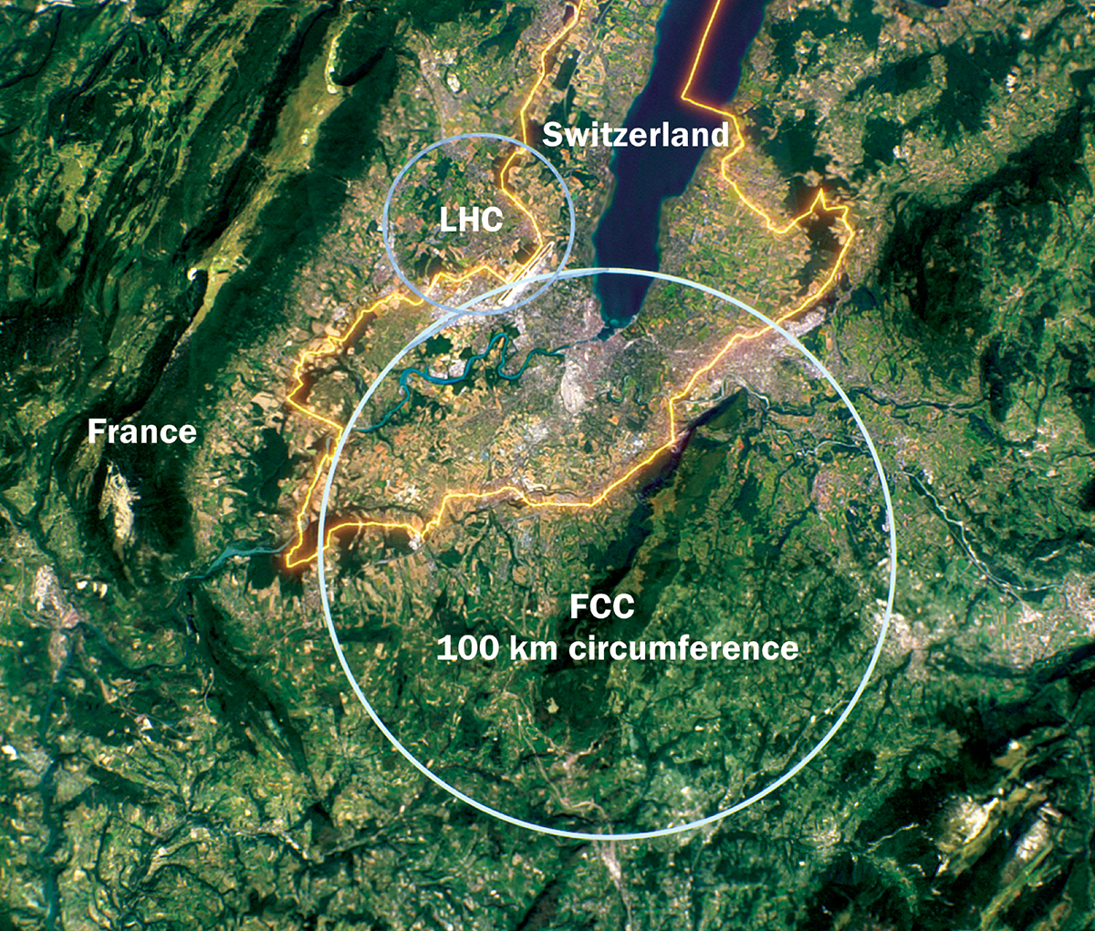
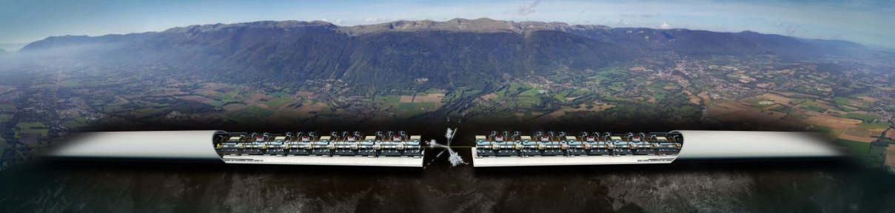
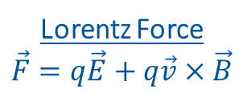
Introduction to Accelerators
Principle: Accelerate particles with electric field, and analyze collissions with target.
Types:
Linear accelerators - Linear accelerator 4 (Linac4)
Limitation to high collission energy is electric field
Breakdowns can destry radio frequency cavities
Circular accelerators - Large Hadron Collider (LHC)
Limitation to high collission energy is electric field
Quenches can destroy magnets
Current LHC status: LHC page 1
Lorentz Force
$$\vec{F}=q\vec{E}+q\vec{v}×\vec{B}$$
CLIC concept image

Slide 4
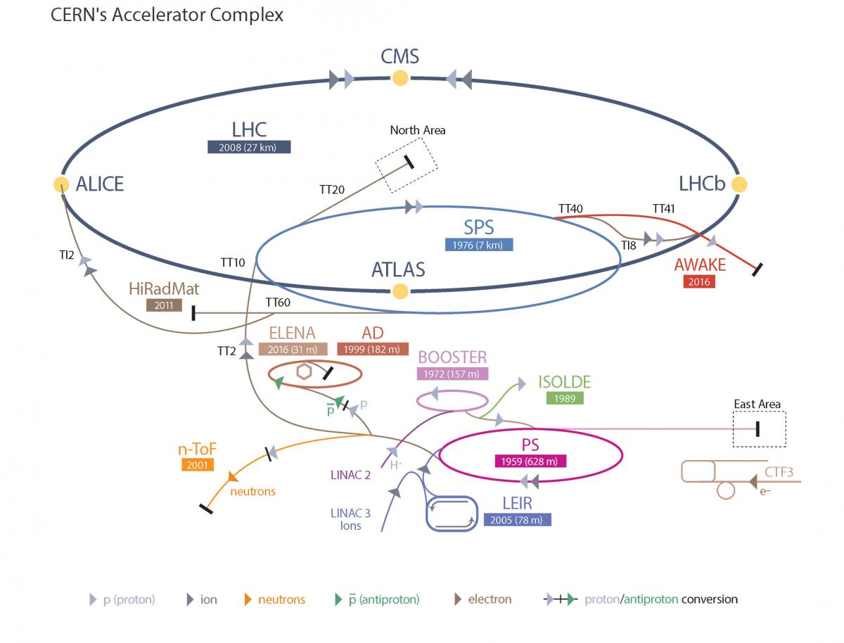
Large Hadron Collider - LHC
LHC Facts
Cost of the LHC | 4332 MCHF
Length | 26 659 m
Dipole operating temperature | -271.3°C
Cost per magnet | ~ 1 MCHF
Number of main dipoles | 1232
Power consumtion | 1.3 TWh/a
Number of circuits | 8
Stored energy per circuit | 1.1 GJ (380-ton TGV @ 50km/h)
10/24/2022

Slide 5
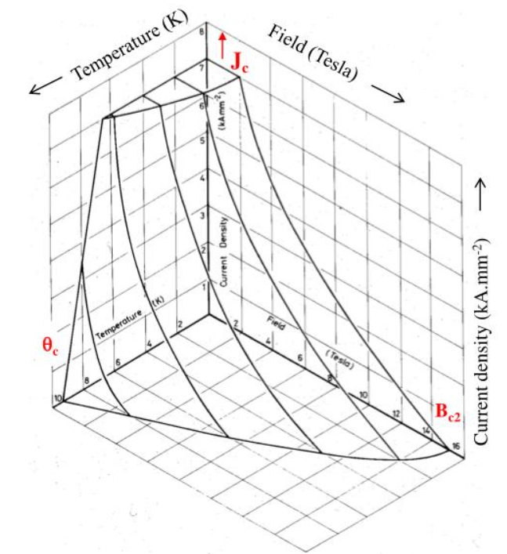
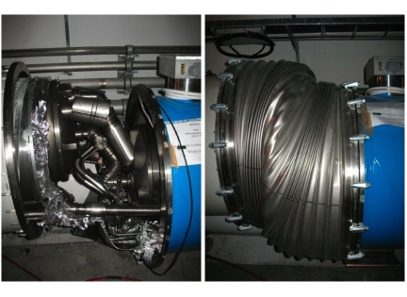
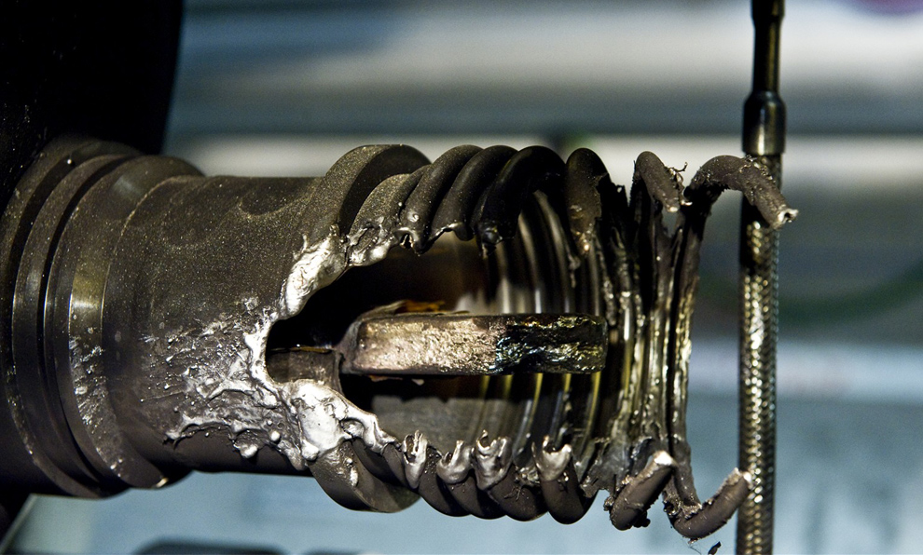
Quench Protection
Quench is biggest threat to LHC dipole magnets
Different types of quench:
Primary quench
Secondary quench: GHe propagation, EM disturbance,..
Quench Protection:
Bypass Diode
Quench Heater
Quenches with destructed magnets:
2008 (~100 destroyed magnets – splice opened)
2021 HWC (1 destroyed magnet - interturn short in coil)
Possible precursor detected 1 month before
Precursor: Oscillation in U_Diode Voltage
Goal: Further precursors?
Critical surface NbTi

Slide 6
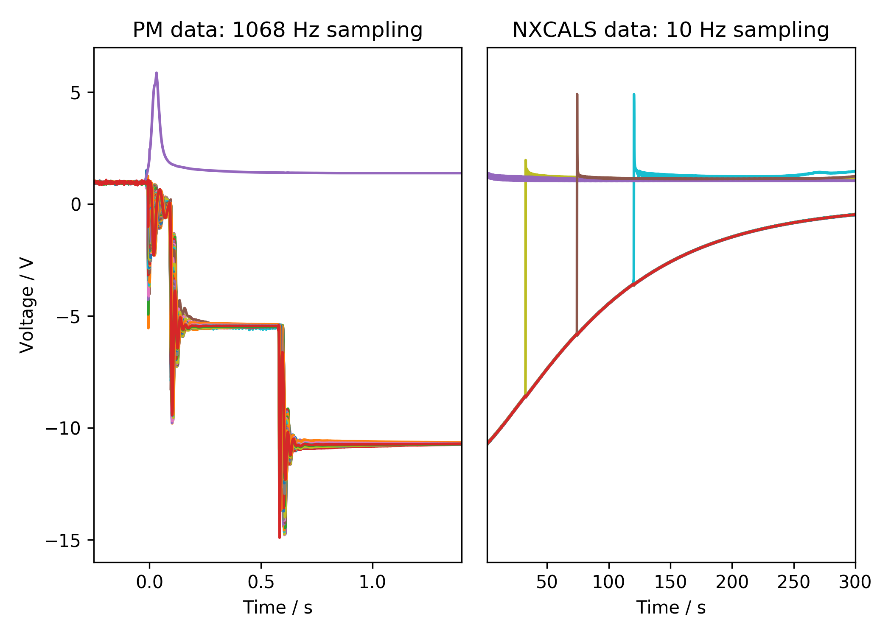
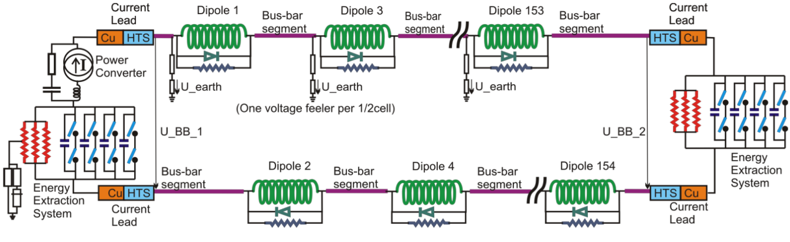
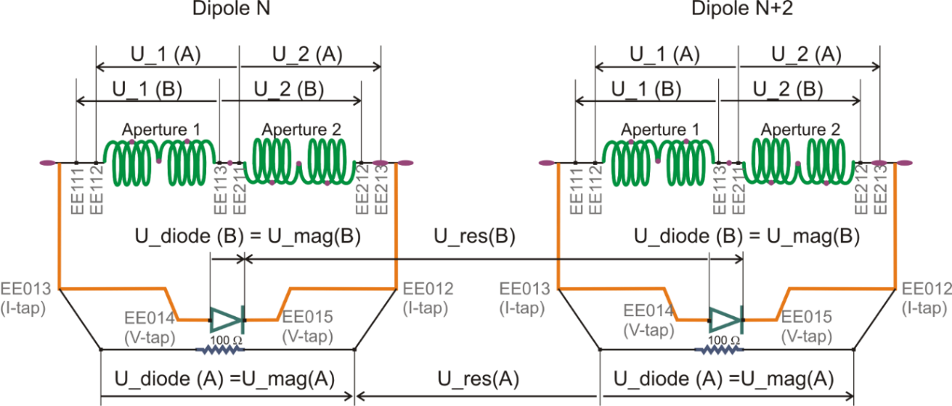
Quench Protection: U-Diode
Interesting area
2nd EE switch off
Secondary quench
1st EE switch off
PC Switch off

Slide 7
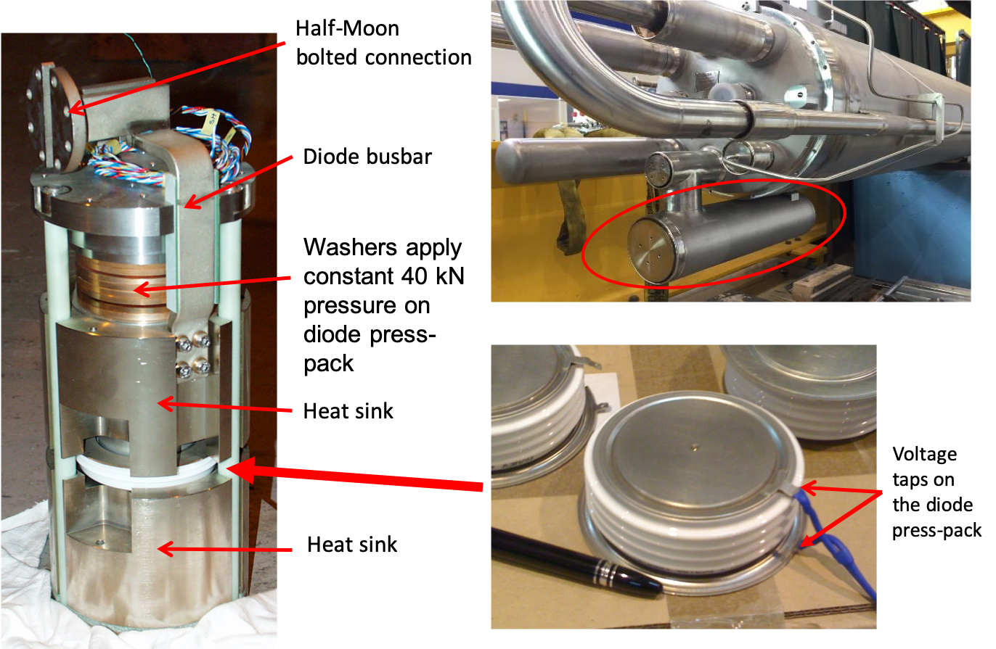
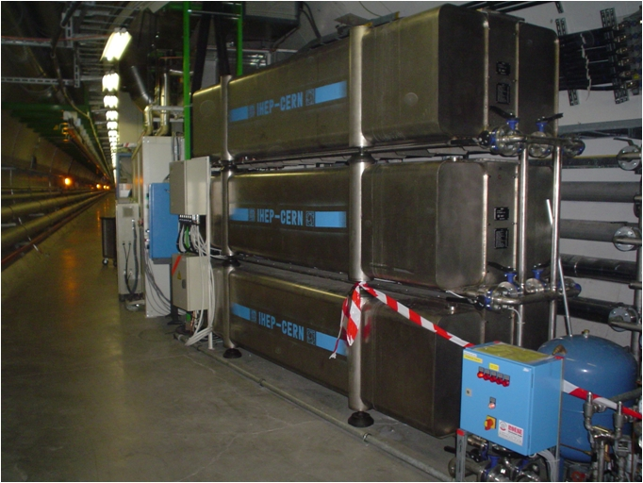
Hardware
Diode
Energy Extraction Resistance

Slide 8
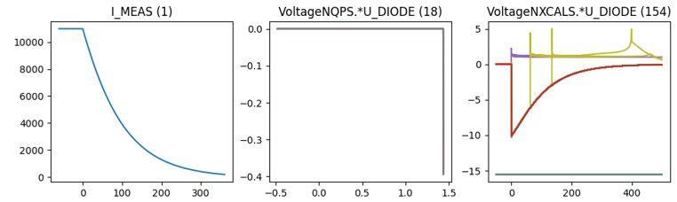
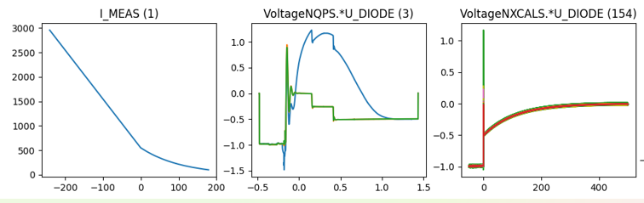
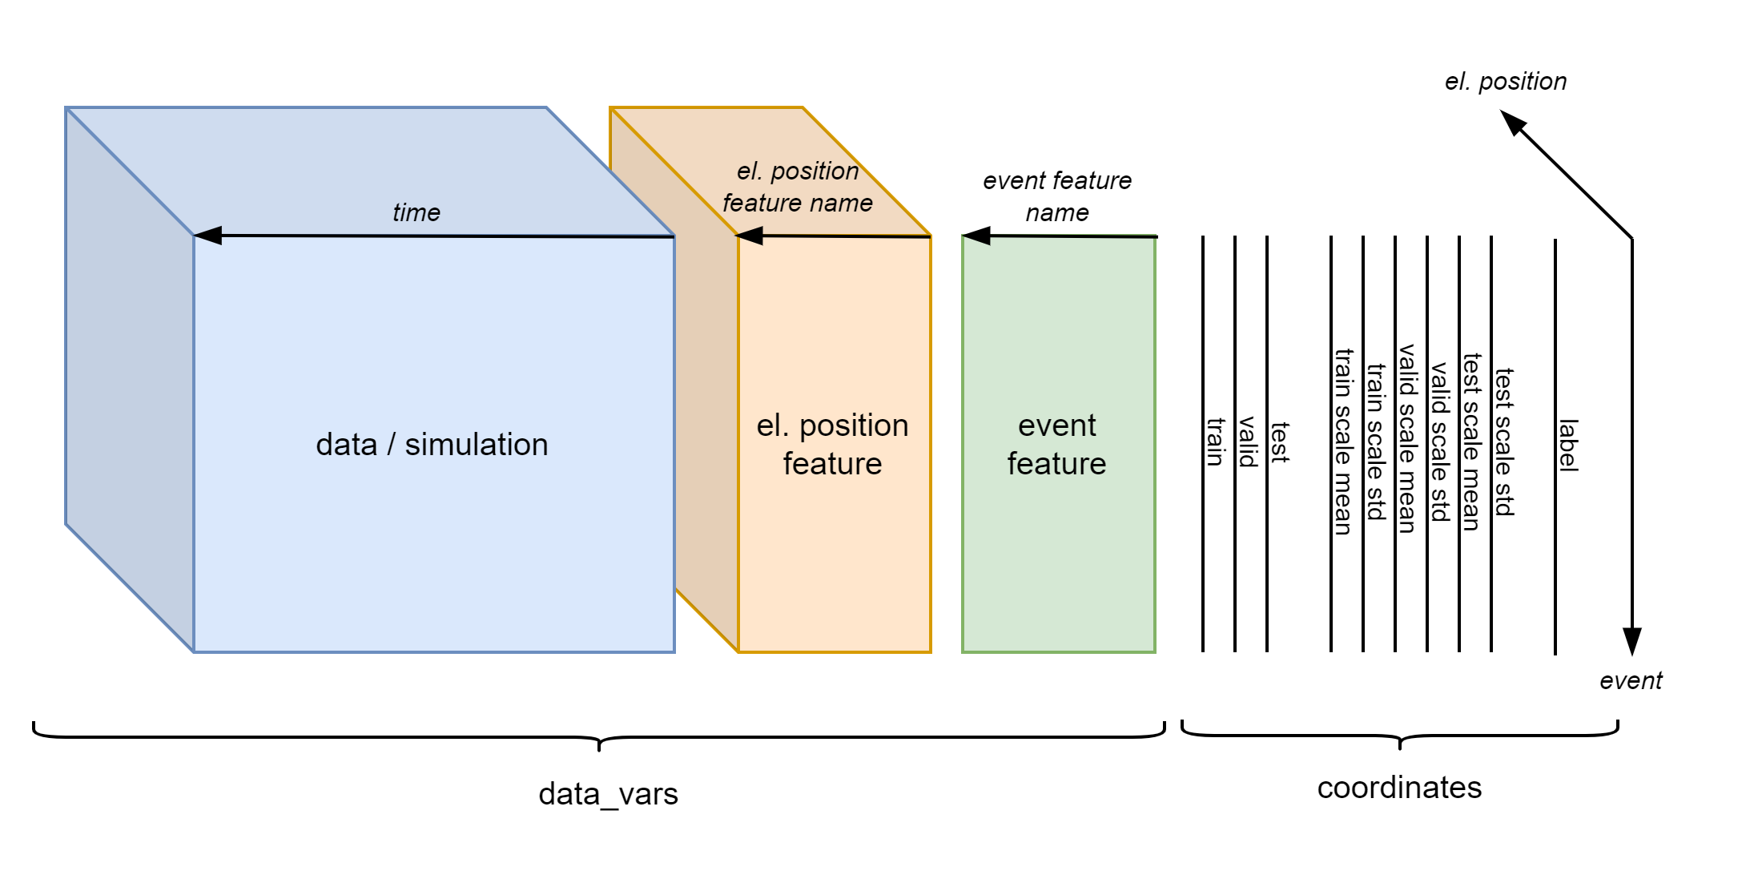
Existing Database Overview
Data overview
Filtered events
 | Signal | 2014-2020 | 2021 | # events
Real Data | U_DIODE_NXCALS | P | P | 867
 | U_DIODE_PM | P | P | 629
 | I_MEAS | P | P | 896
 | U_QSO, U_1, U_2 | P | P | 893
 | I_EARTH_PCNT | P | P | 895
 | I_EARTH | P | P | 629
 | I_HDS, U_HDS | P | P | 896
 | EEUDumpResPM | P | P | 896
Simulations | V(0v_magf*) | P | P | 875
 | I(r1_warm) | P | P | 875
 | V(10,11), V(18,19) | P | P | 875
#events |  | 267 | 629 | 560/896

Slide 9
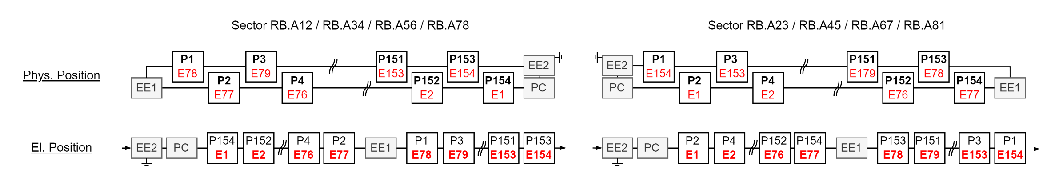
El. Vs Phys. Position

Slide 10
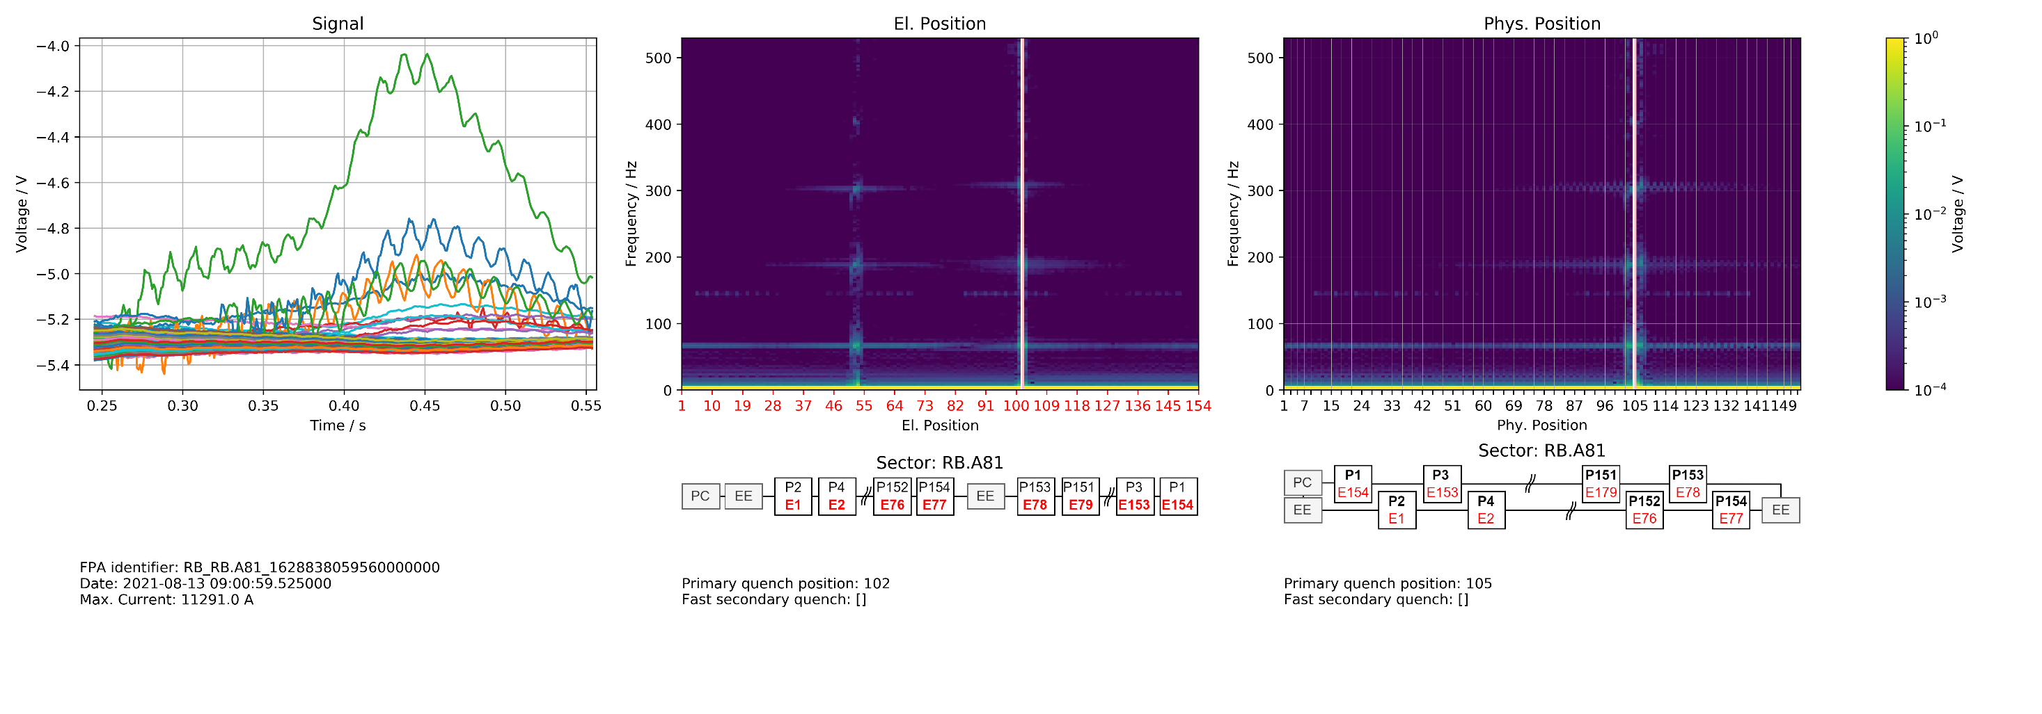
Position Frequency Map

Slide 11
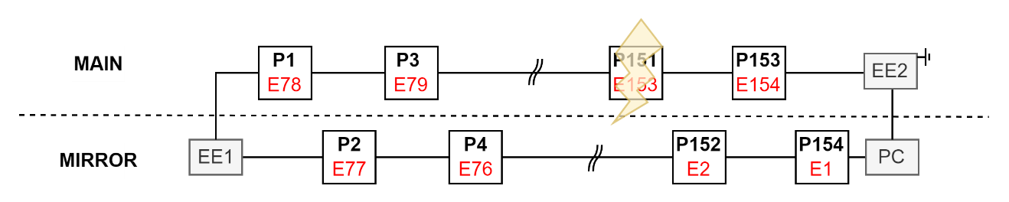
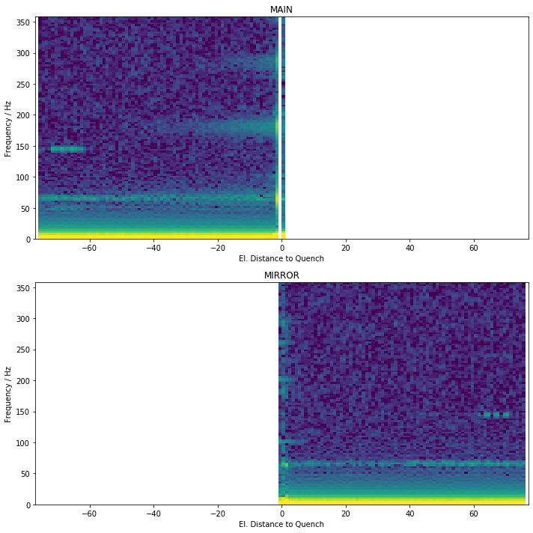
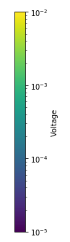
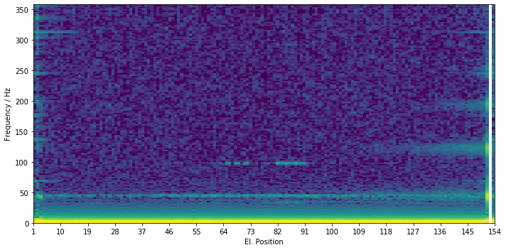
Generalization
To calculate statistics, quench must occur at same position
Not consider events with secondary quenches
Split into
MAIN: Half where quench occurred
MIRROR: Other Half

Slide 12
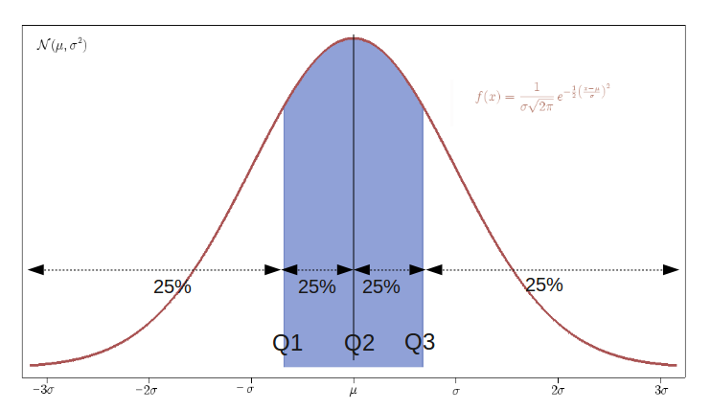
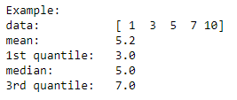
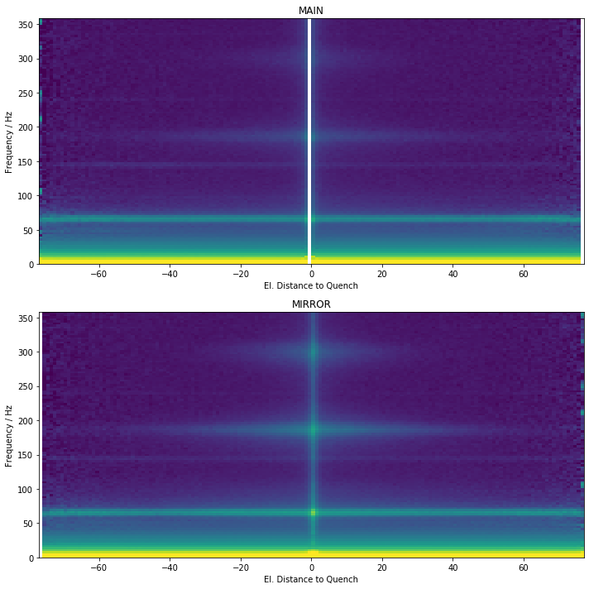
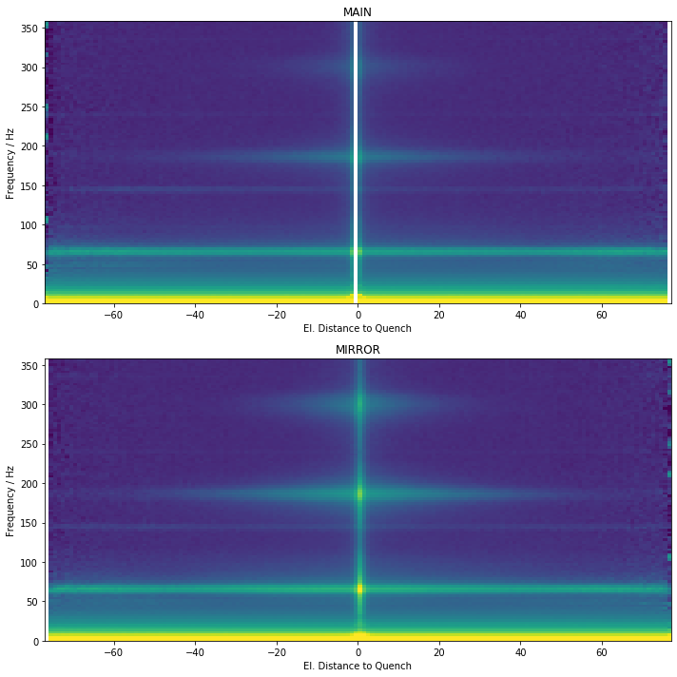
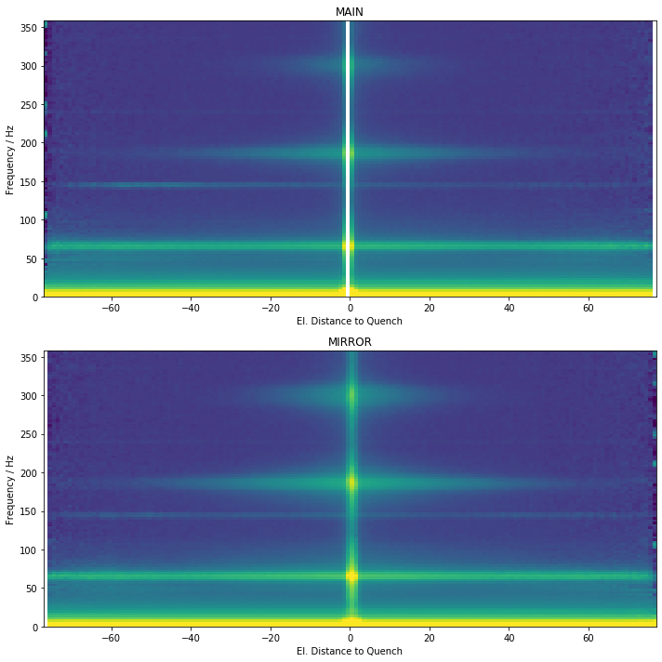
Quantiles
1st quantile
median
3rd quantile

Slide 13
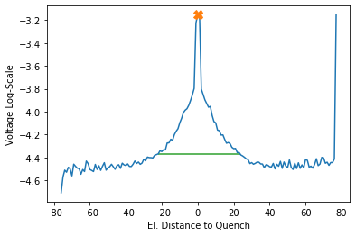
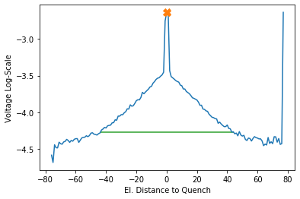
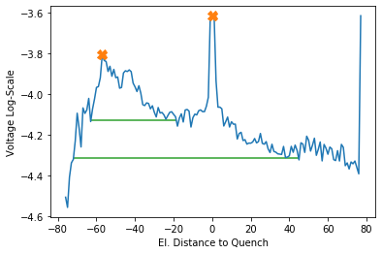
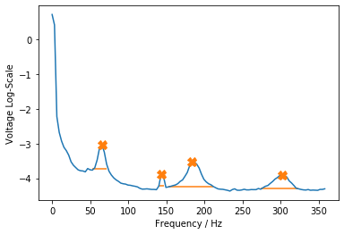
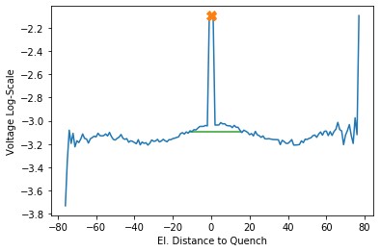
Find Peaks
302.1 Hz
183.8 Hz
143.3 Hz
65.4 Hz

Slide 14
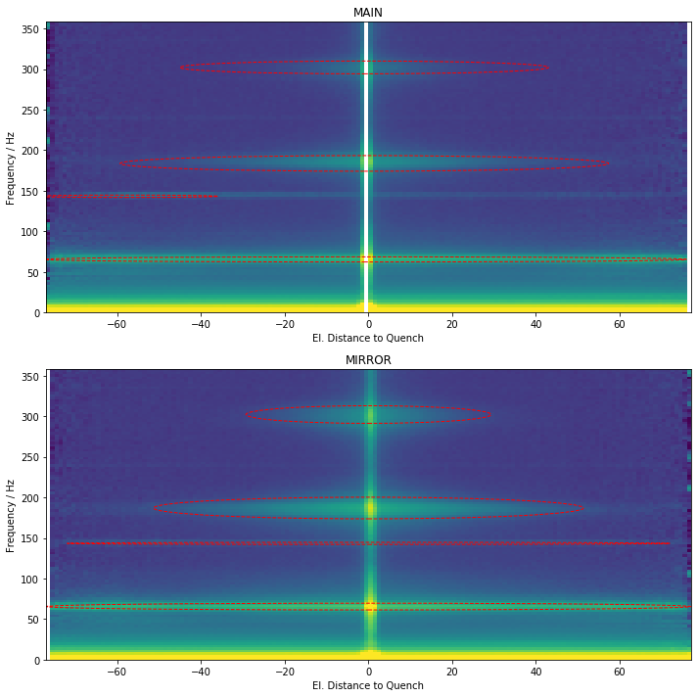
Find Peaks

Slide 15
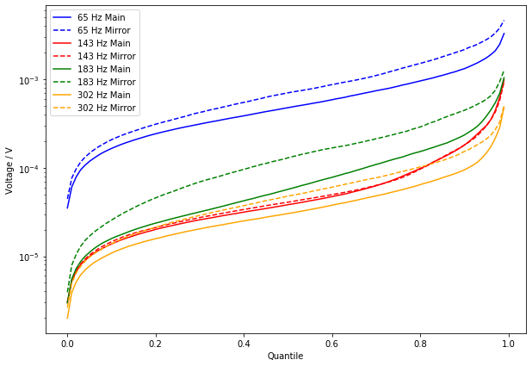
Voltage = f(Quantile)

Slide 16
Non-Negative Matrix Factorization

Slide 17
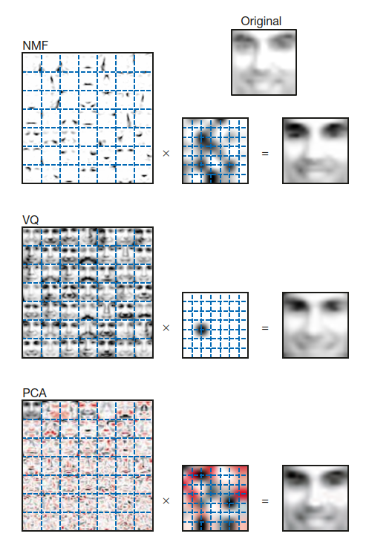
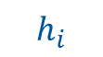
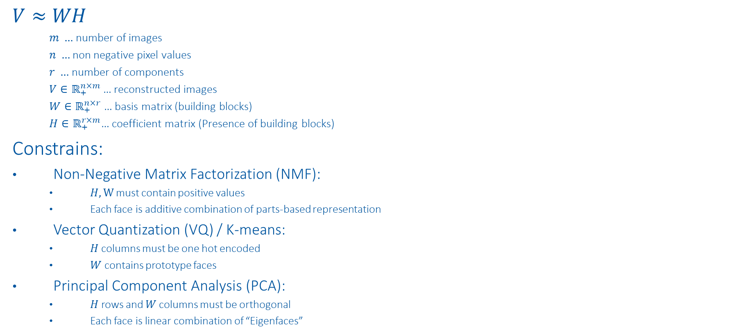

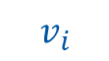
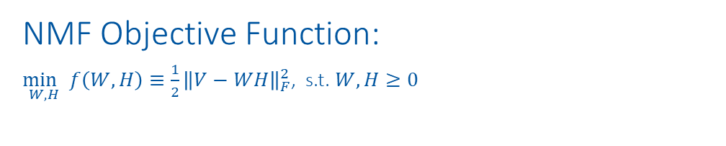
NMF vs. VQ vs. PCA
$$W$$
$$h_{i}$$
$$V≈WH$$
$m …$ number of images
$n …$ non negative pixel values
$r …$ number of components
$V∈ℝ_{+}^{n×m}$… reconstructed images
$W∈ℝ_{+}^{n×r}$… basis matrix (building blocks)
$H∈ℝ_{+}^{r×m}$… coefficient matrix (Presence of building blocks)
Constrains:
Non-Negative Matrix Factorization (NMF):
$H,W$ must contain positive values
Each face is additive combination of parts-based representation
Vector Quantization (VQ) / K-means:
$H$ columns must be one hot encoded
$W$ contains prototype faces
Principal Component Analysis (PCA):
$H$ rows and $W$ columns must be orthogonal
Each face is linear combination of “Eigenfaces”
NMF Objective Function:
$\underset{W,H}{\min{ }}f\left(W, H\right)≡\frac{1}{2}{\left\|V−WH\right\|}_{F}^{2}$, s.t. $W, H≥0$
$$v_{i}$$
https://www.nature.com/articles/44565
https://proceedings.neurips.cc/paper/2000/file/f9d1152547c0bde01830b7e8bd60024c-Paper.pdf

Slide 18
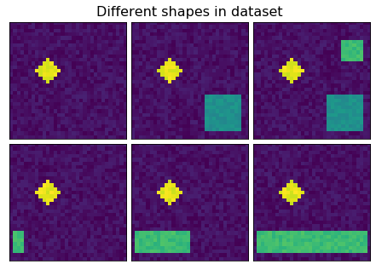
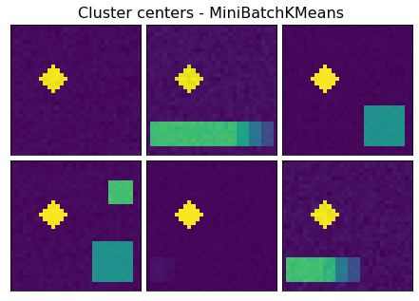
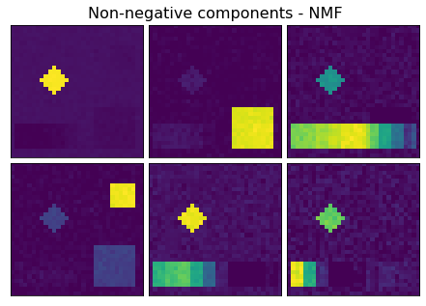
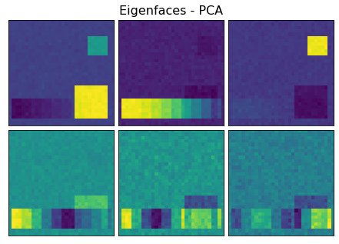
Toy example
50x
30x
10x
1x
1x
1x

Slide 19
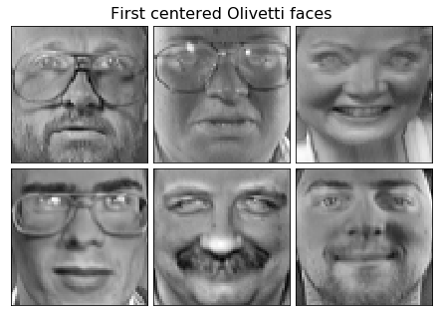
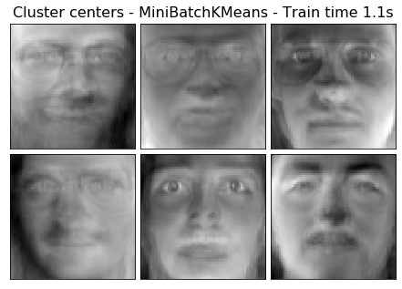
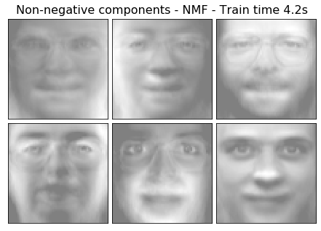
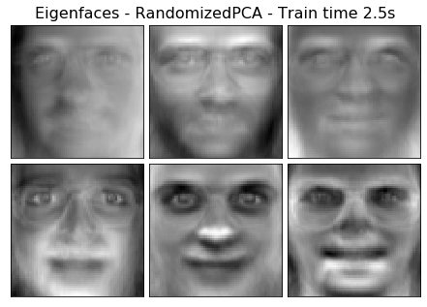
Face example

Slide 20
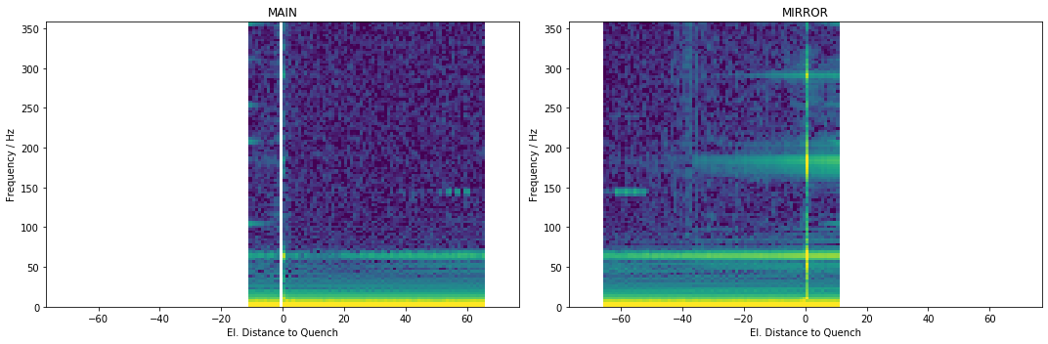
NMF for Position Frequency Maps
Oscillation from quench
Oscillation from border

Slide 21
NMF for Position Frequency Maps
Challenges:
NMF with NAN values exists, but model adjustments make result much worse
Map parts have different origins
Oscillation from quench
Oscillation from border

Slide 22
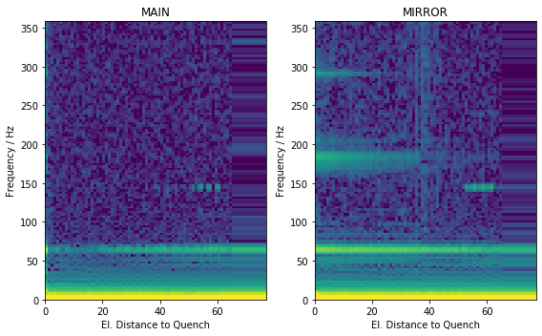
Preprocessing
Take half with more data
Interpolate nan values

Slide 23
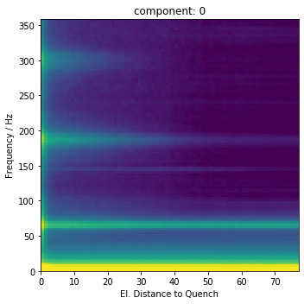



NMF - MIRROR
n_components = 4

Slide 24






NMF - MIRROR
n_components = 6
Event with secondary quench ->
(anomaly in this dataset)

Slide 25




NMF - MAIN
n_components = 4

Slide 26






NMF - MAIN
n_components = 6

Slide 27
Summary
Interpretation is key:
Check assumptions (e.g. scaling, processing)
Discussion with experts (no ML, algebra, statistics knowledge)
Avoid over-engineering
Check NMF components:
Do I just detect processing features (e.g. interpolation)

Slide 29
Sanity Checks

Slide 30




Kirchhoff
$$−U_{BB_{1}}+U_{BB_{2}}+\sum_{n=1}^{154}{U_{Diode}\left(n\right)}=0$$
Challenges: (1) Sampling (2) Time-alignment

Slide 31


FFT sanity check

Slide 32

Data - Simulation

Slide 33

Next Steps
Further improve plots, according to experts
Add FFT phase to track wave propagation
Find expected oscillation after quench $→$ adjust simulations (PSPICE)
Find oscillation anomalies $→$ precursor of magnet failure?
Possible method to find prototypes in position frequency map: NMF codebooks?

Slide 34



Signal vs. scaled signal
Signal
Scaling: $x_{scaled}=\frac{x−mean\left(x\right)}{std(x)}$
Scaled Signal

Slide 35

Overview of Data-Driven Models
High incorporation of knowledge and context
Data-Driven Models
Manual Feature Engineering
Manual Threshold
Probabilistic
Classic Machine Learning
Automatic Feature Eningeering
Discriminative Deep Learning
Generative Deep Learning
GAN, RNN, ProtoNET
MLP, DCNN, FCN
SVM, Random Forrest, MLP
e.g. Busbar Resistance
e.g. QH Analysis
Fully data driven
Physical Models
Dataset | 1. Feature analysis | 2. Find probabilities/correlations | 3. Finding concepts | 4. Predict parameters | 5. Generate data
1. U Diode Secondary Quench | Oscillation types | Oscillation evolvement
2. U Diode Primary Quench | Oscillation types | Oscillation evolvement | tSNE concepts | Predict sec. quench
3. U Diode Full Quench |  |  |  | Fit simulations | Reconstruct data

Slide 36


1. U Diode Secondary Quench

Slide 37


Manual Feature Engineering
Classification of oscillations after secondary quenches
-2
0
150
-1
1
151

Slide 38


Manual Feature Engineering
2
3
4
2
3
1
min_time, max_time
min_amplitude, max_amplitude
dU_min, dU_max
dstd_max
wiggle_area_pos, wiggle_area_elpos
dstd score: $\frac{mean(wiggle area)}{mean(non wiggle area)}$
Using phys. position, el. position
Different window functions
5
5

Slide 39





1. Oscillation that only propagates electrically
Reason: electric coupling?
2. Oscillation that propagates physically and electrically
Reason: electric coupling through grounding?
Special case: Oscillation in only one magnet
3. Oscillation due to another quench in time window
Reason: coupling of magnets
4. Oscillation due to acquisition
Reason: acquisition
Manual Threshold

Slide 40

Find Probabilities
Wiggle: How does the dstd score evolve in B28L8, compared to other magnets
Probabilistic

Slide 41



2. U Diode Primary Quench
U Diode PM
1st Energy Extraction
Frequency Domain

Slide 42




Sunglass Threshold
Effect threshold to #quenches.
Filter: 20ms moving average

Slide 43




Frequency Domain
Calculate real valued FFT out of scaled input for all magnets.
Scaling: $x_{scaled}=\frac{x−mean\left(x\right)}{std(x)}$

Slide 44


2D-tSNE Frequency Domain
tSNE input: all maximal frequencies per magnet (events, frequency)

Slide 45

2D-tSNE Frequency Domain
tSNE input: all maximal frequencies per magnet (events, frequency)

Slide 46

2D-tSNE Frequency Domain
tSNE input: all maximal frequencies per magnet (events, frequency)

Slide 47









Finding concepts – tSNE overview
Example: Project 2D space to 1D space
2D space
1. Mapping distance between all points to distribution
1D space
Random initialization
Mapping distance between all points to distribution ($σ_{i}=\frac{1}{\sqrt{2}}$)
Distributions of 2D space should be similar to 1D space -> Minimize sum of all KL-divergences
KL-divergence
$$min⁡C$$
Classic Machine Learning

Slide 48





Finding concepts
Find different concepts of different anomalies in data
Example: Concepts in EE plateaus of U_diode PM
2D-tSNE axis 2
2D-tSNE axis 1
Classic Machine Learning

Slide 49
2. U Diode Full Quench

Slide 50


Predict parameters
a.) Neural netlist optimization: Improve simulations with gradient descent
b.) Predict fast secondary quenches with CLIC approach: Use Explainable AI to see what the NN was looking at
Discriminative Deep Learning

Slide 51


Generate data
Can ML generate data faster/more accurate than simulations? Using the same input
Optimization of decoder weights with MSE between real data and simulated data
Advantages:
Decoder can create within seconds, more similar to real data
Detection of anomalies with MSE
Disadvantage: Black box
Generative Deep Learning

Slide 52


Generate data
Can ML generate data faster/more accurate than simulations?
Generative Deep Learning

Slide 53
Discussion
Feature analysis:
Analyze both EE sunglasses, dependent on threshold, also within event
Find probabilities:
How does the dstd score evolve in B28L8, do other magnets evolve similarly?
Find concepts:
tSNE per magnet, look at frequency domain
Predict parameters:
Optimization of magnet parameter, research PSPICE optimization techniques
Generate data:
Simulation data will be improved
Check data integrity: sum of all u diode signals + ee signals should be 0
Also use: UQS0, Voltage feelers, Quench heaters
Genetische Optimierung,

